Slide 1
An Introduction to OKRs, and Microsoft Viva Goals
Version 1.0
Notes:
An Introduction to OKRs and Microsoft Viva Goals
Viva Goals is an exciting new offering from Microsoft as part of the Microsoft Viva Employee Experience family. It aims to help businesses, senior management, define and plan their strategy and align the business to it.
This talk will introduce you to OKRs and Microsoft Viva Goals using discussion, hints and tips, and demos.
The talk discusses and answers the following
What challenges are OKRs looking to solve?
What are OKRs?
Why would you want to implement OKRs?
What is Microsoft Viva Goals?
What licensing do you need?
What are the concepts within Viva Goals?
How do you get going with OKRs and Viva Goals?
Send you away with a set of resources so you can get started on your journey.

Slide 2
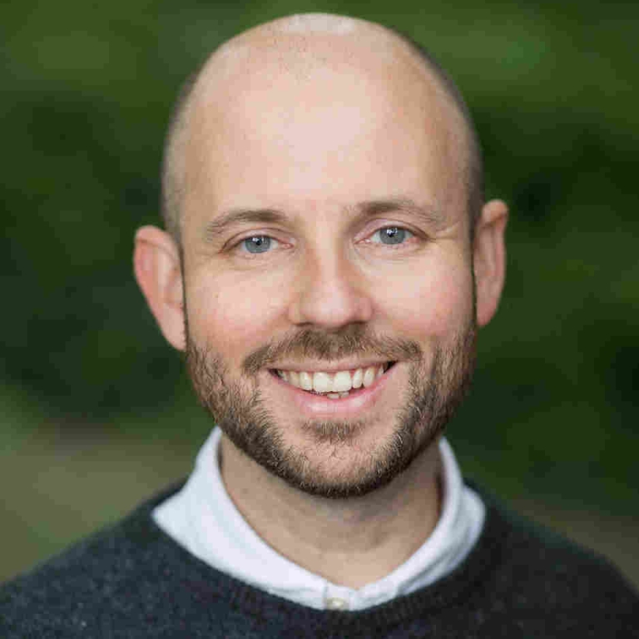

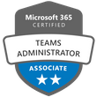

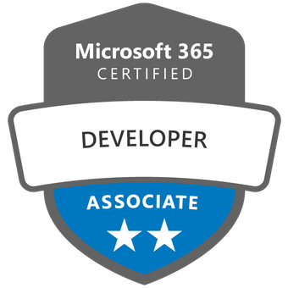
Simon Doy
Founder of iThink 365
Chief Technical Officer
Introduction
20+ years in IT
Architect / Developer
M365 North User Group Leader

Slide 3

Agenda
The challenge
What the heck is an OKR?
Why Viva Goals?
How?
Demos
Questions
Agenda
Photo by shen tony on Unsplash

Slide 4
The Why - Challenges

Slide 5

What are the challenges?
Photo by shen tony on Unsplash
Notes:
What challenges are we trying to solve?

Slide 6

Businesses that have a plan – succeed!*
The Why
Photo by Daniel Gonzalez on Unsplash
Notes:
We want the business to be successful and grow. We want it to succeed.
One of the key habits for a successful business is to have a plan.
As Benjamin Franklin said ““If You Fail to Plan, You Are Planning to Fail” — Benjamin Franklin.
By having a plan, the business has direction and knows where it is going. Sure on that road we might make a few wrong turns but we are present whilst we are on that journey and not just meandering around.

Slide 7

How do you communicate that plan?
The Why
Photo by Pavan Trikutam on Unsplash
Notes:
Great so you have a plan, how do you communicate the plan through the business?
You could use the Intranet to define the strategy but when you get into the detail it is difficult to communicate the changes and keep people in the know.
The plan also is likely to be high level or aimed at the business or department, but then how does that plan break down for the individual? How do they contribute to the plan?

Slide 8
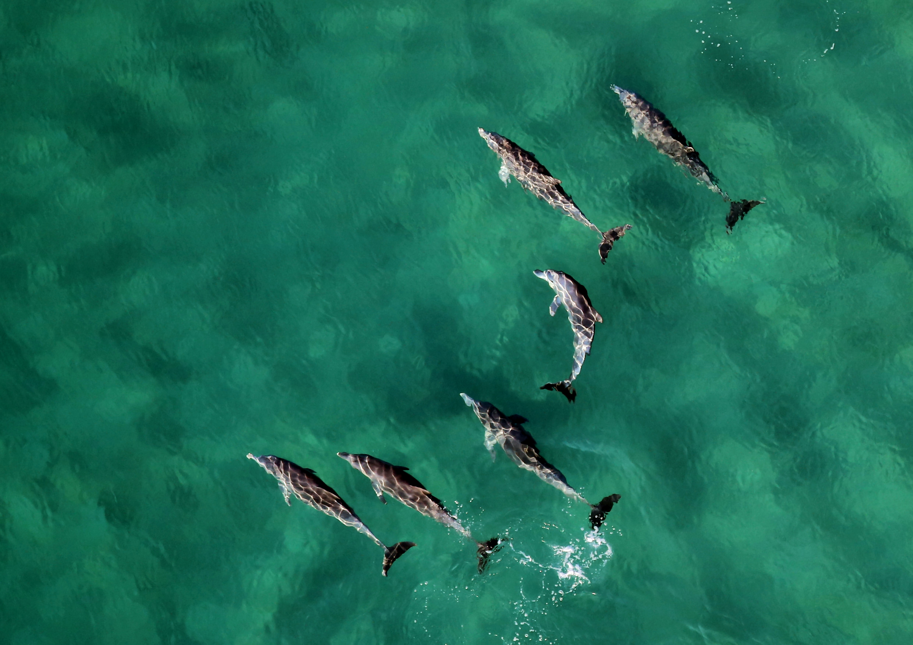
How do you align your teams so they work on the important stuff?
The Why
Photo by Wynand Uys on Unsplash
Notes:
Additionally, we might have a plan which that has been communicated rolled out to the business, department and teams but how do we align to the individuals so that they are working on the things that are important to the business?
Additionally, explaining why they are working on these things helps give them a sense of purpose they can see that how what they are doing is benefiting the business.

Slide 9

How do you track that alignment?
The Why
Photo by Possessed Photography on Unsplash
Notes:
This follows on from the previous slide, when you have the plan and the actions how do you then track that you, department and individuals are on track and working on the plan?

Slide 10

How do you know that you are on track and have met your goals?
The Why
Photo by JOSHUA COLEMAN on Unsplash
Notes:
Finally, how do you know that you have are on track and most importantly that you have something in place that measures when you have met the goal!

Slide 11

An approach is to use OKRs
The Why
Photo by Pascal Habermann on Unsplash
Notes:
An approach to tackling these challenges is to use OKRs
OKRs was invented by Andy Grove in the 1970s.
Andy Grove and OKRs, the 1970s
As a CEO at Intel, Andy Grove took the idea of MBO from Peter Drucker and upgraded it with the concept of Key Results. Thus, OKRs were born, and Andy Grove became the father of the OKR framework.
John Doerr and Google, 1999
Among the management team at Intel was John Doerr, who later went on to become a legendary Silicon Valley VC working at Kleiner Perkins Caufield & Byers. In 1999 Kleiner Perkins invested in Google, and John Doerr became an advisor to Google. As an advisor, J. Doerr introduced OKRs to Google in 1999. The idea caught up, Google founders Larry Page and Sergey Brin adopted it across the whole team (around 30 employees at that time). Since then, OKRs became an integral part of the Google culture and DNA. John, Larry, and Sergey credit OKRs for the staggering Google growth, many innovations, flat hierarchies in the team, and high employee morale (book "How Google Works").
“OKRs have helped lead us to 10x growth, many times over. They've helped make our crazily bold mission of "organizing the world's information" perhaps even achievable. They've kept me and the rest of the company on time and on track when it mattered the most."Larry Page, CEO of Alphabet and co-founder of Google.
What Google did differently about OKRs, they reduced the planning cycle to just a quarter. It allowed for a faster pace and innovations happening rapidly.
OKRs after Google, 2010+
The growth of Google to one of the most valuable companies in the world popularized the concept of OKRs. Google launched a resource re:Work to share its OKR principles. John Doerr published a book about OKRs "Measure What Matters."
Many companies started adopting the OKR framework. Among them is Airbnb, LinkedIn, Dropbox, Spotify, Netflix, Amazon, Facebook, Gap, Lear, Deloitte, and Adobe. Each of the companies adopts the methodology for their needs. For example, Spotify ditched the individual OKRs, since they don't work.
Important to note that OKRs don't aim to fix all the management and leadership gaps. They're just a tool that a skilled craftsman can use to boost team productivity and reach the moonshot Objectives.

Slide 12
The What

Slide 13

What is an OKR?
The What
Photo by Vadim Bogulov on Unsplash
Notes:
So what is an OKR?

Slide 14

OKR = Objective + Key Result
The What
Photo by Vadim Bogulov on Unsplash
Notes:
OKR stands for Objective and Key Result.

Slide 15

Objective
What are we trying to achieve?
The What
Photo by Tom Briskey on Unsplash
Notes:
Objective – this is the aim of the activity, what is that we are trying to achieve, the objective or goal.
They can be tricky to define but we can help with tips on what makes a good objective or goal.

Slide 16
What is a good objective?
SMART
Specific
Measurable
Achievable
Realistic
Timely
The What
Photo by Daniel Gonzalez on Unsplash
Notes:
So what makes a good objective?
There are a couple of schools of thought and Microsoft in their adoption guide have a slightly different approach but this is what has worked for us at iThink 365.
The goals are defined as a short sentence.
The Goals need to be Smart:
Specific – we need to be able to describe exactly what we are looking to achieve in the sentence
Measurable – we need to be able to know when we have succeeded so we need to be able to measure the goal to track alignment and success. So how many or how much do we need to achieve?
Achievable – This is where Microsoft adoption guide and others differ they should be achievable there isn’t much point of going for the goal if it is completely impossible to achieve.. However you do not want to make them too easy either. There needs to be some stretch to make it.
Realistic – Is this something that we can do, is it possible in the timescales?
Timely – we need to have an idea of how long is it that we have to met the goals as this creates the motivation and urgency.
Do not talk about emotions here… go to next slide ☺

Slide 17
What is a good objective?
Emotion
Why do you want to achieve this?
What will it mean to you?
The What
Photo by Daniel Gonzalez on Unsplash
Notes:
We need to discuss the why of the objective and get some emotion?
Other parts of a good objective is that you understand why you are looking to achieve this goal.
What does it mean to you?
What does it mean to you team, and the organisation?
How will you feel when you achieve it?
What will you feel?
If you are not going to feel anything from it then its probably not a good goal.
Pick something else
Some examples
Increase number of linked in followers by 100 in 90 days.
Increase turnover by 10% in 90 days or better still increase turnover to 100K a month in 90 days.

Slide 18
Key Result
Key Performance Indicator(s)
Measures the goal to track progress and identify when objective has been met
The What
Photo by Daniel Gonzalez on Unsplash
Notes:
Key result is the measurement.
We have a SMART goal so we know what we need to achieve as it is measurable but now we need to measure it.
This is the key result or Key Performance Indicator (KPI).
These need to be updated regularly so that we can see how we are progressing on the goal and when we have met the goal.

Slide 19
How?
Notes:
So that is great we have covered the key aspects of OKRs… How?

Slide 20
Viva Goals enables OKRs
How?
Photo by Daniel Gonzalez on Unsplash
Notes:
So Viva Goals enables or provides a framework for OKRs in your business.
It is part of the Microsoft 365 eco system and enables you to define, action, visualise, and report on your business’s plan.

Slide 21
OKR Definition Process
OKRs are defined and agreed at business top-level
Supporting department, team and individuals OKRs are defined and agreed
Business
Define OKRs
Departments
Define OKRs
Individuals
Define OKRs

Slide 22
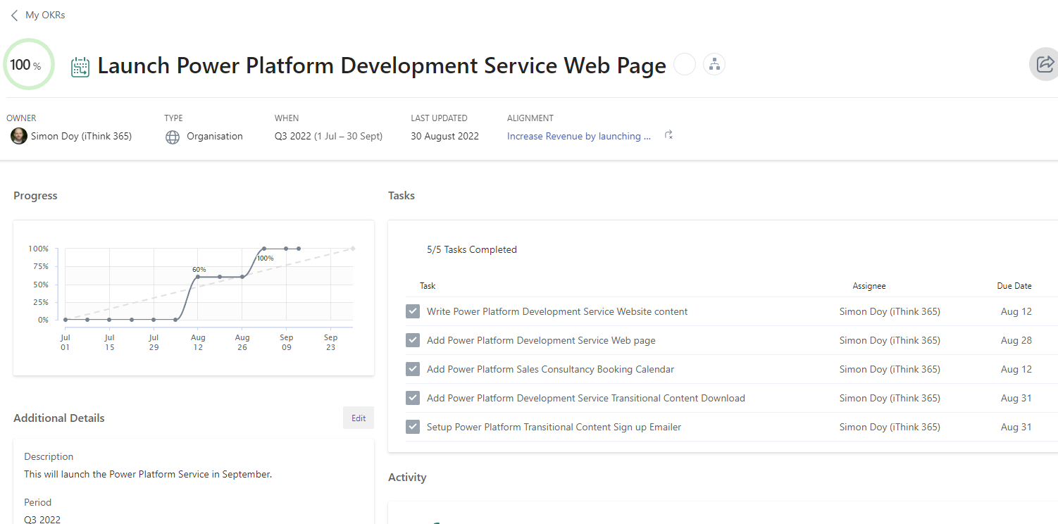
How to achieve the OKRs?
Projects
  Workstreams which support delivering an objective
Tasks
  The activities that make up the project.
Notes:
When we

Slide 23
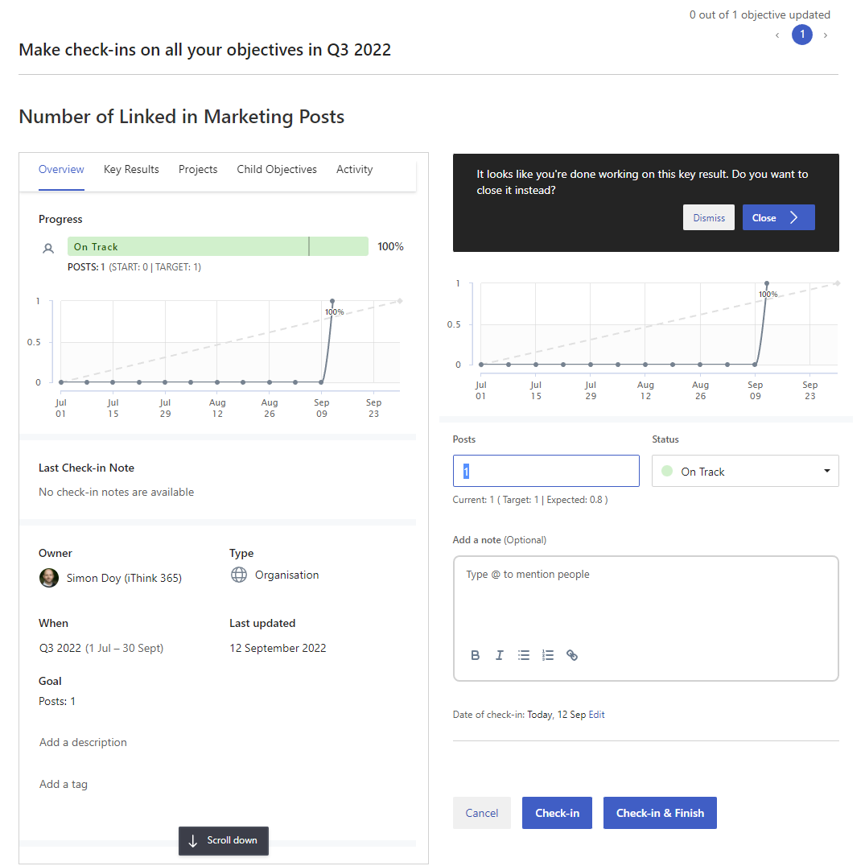
Monitoring the OKRs
Via Check ins
  Manual
  Automatic
Organisation decides on the check-in frequency
Notes:
When we

Slide 24
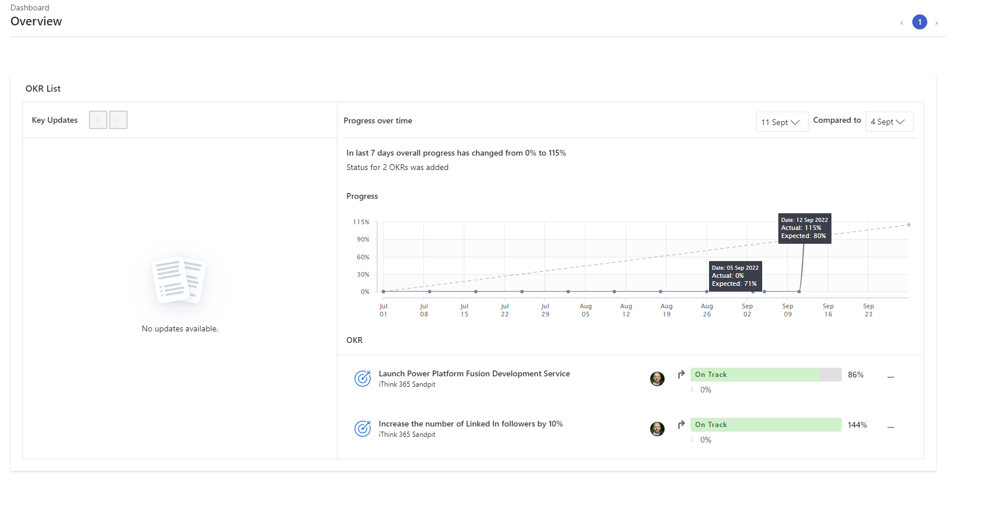
Reporting and Presenting Progress
Viva Goals Dashboard
Presentation mode
Notes:
When we

Slide 25
Demonstration
Viva Goals and OKRs
Notes:
Viva Goals is available in Microsoft Teams or via https://goals.microsoft.com
Demo creating an organization
Showing the Quarters.
Demo creating a department and team
Demo creating an objective for the business. (Increase LinkedIn Followers to 500 in 90 days)
Demo creating a key result
Measurement – manual vs auto
Show the process to check Check in – manually
Dashboards and reporting
Setup a Check-in automatic – show SQL Server and Linked In Followers.

Slide 26
Next steps
Next
Viva Goals and OKRs
Notes:
Microsoft Teams

Slide 27

Licensing
Viva Suite - £6.80 per user per month
Adoption
Viva Goals - £4.50 per user per month
Photo by Daniel Gonzalez on Unsplash
Notes:
Licensing
Few routes including
Viva Suite
Individual Viva Goals licensing

Slide 28
Adoption Approach
Read the Viva Goals Adoption Guide
Adoption
Photo by Daniel Gonzalez on Unsplash
Notes:
Microsoft Adoption Guide
Read the Microsoft Adoption Guide
Approach is Educate yourself, building a team of champions
Educating the champions and the workforce.
Start off with a pilot, for me it makes sense to get the senior management bought into it as it is for them initially.
Communication and Education
Start small and build

Slide 29
Useful Resources
Viva Goals Adoption Guide
  https://adoption.microsoft.com/files/viva/goals/Viva-Goals-Adoption-Guide.pdf
Ultimate Guide to OKRs
  https://www.perdoo.com/okr-guide/
Getting started with Viva Goals – Microsoft Learn
  https://docs.microsoft.com/en-us/learn/paths/viva-goals-get-started/
Getting to know OKRs
  https://docs.microsoft.com/en-us/viva/goals/get-to-know-okrs

Slide 30

What do you think?
Any Questions?

